Slide 1
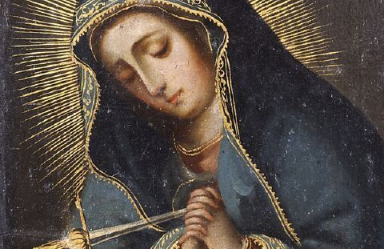
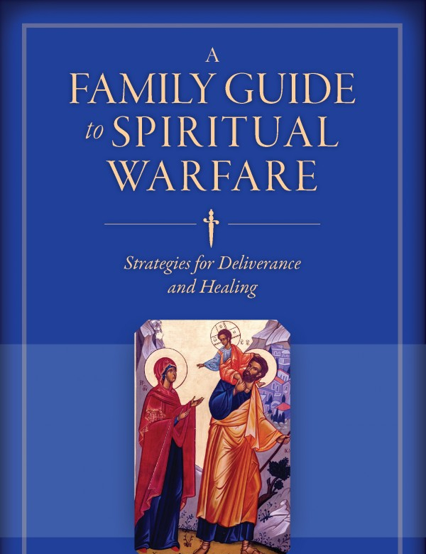
Opening prayer

Slide 2
Presenter
Kathleen Beckman
16 yrs., Diocesan Administrator, Ministry of Deliverance and Exorcism.
16 yrs., on the Exorcist’s Team
6 yrs., Faculty, Pope Leo XIII Institute (post-graduate school for exorcist training), Mundelein Seminary.
2017 Graduate, Assoc. of Int’l Exorcist Course, Pontifical Regina Apostolorum University, Rome
25 yrs., Evangelization in 13 Countries
Author, A Family Guide to Spiritual Warfare & 5 books on prayer, priests, family, healing.

Slide 3
The Goal of this presentation
To assist the individuals/families in identifying the presence of spiritual warfare in their own life;
To encourage everyone to incorporate practices in his life to prevent/minimize the effects of evil;
To assist you to be a source of healing to others; and fulfill the mission of the family.

Slide 4
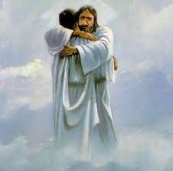
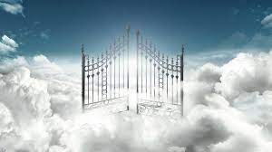
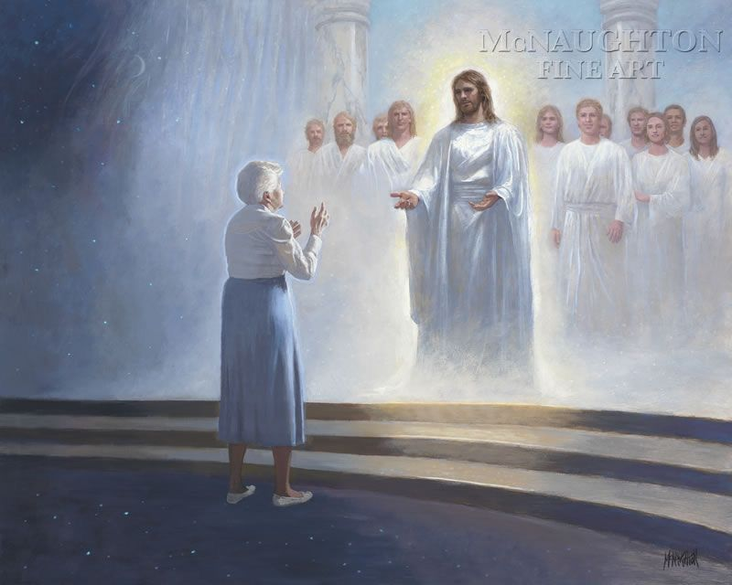
Life’s goal: Heaven
SPIRITUAL BATTLES ARE NOT WON ALONE
YOU NEED A TEAM – JESUS, CHURCH, FAMILY

Slide 5
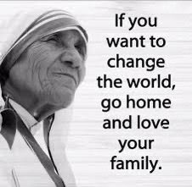

DefendThe the family

Slide 6
ATTACKS AGAINST THE FAMILY ARE AIMED AT MOCKING
GOD.
"The marriage covenant, by which a man and a woman form with each other an intimate communion of life and love, has been founded and endowed with its own special laws by the Creator. By its very nature it is ordered to the good of the couple, as well as to the generation and education of children. Christ the Lord raised marriage between the baptized to the dignity of a sacrament." CCC 1660

Slide 7
The Church’s
Healing Ministry
Pope Benedict XVI: Healing is an essential dimension of the apostolic mission and of Christian faith. It can be said that Christianity is a ‘therapeutic religion, a religion of healing.
Four categories of healing:
  physical healing: the healing from physical sickness and disability;
  psychological healing: the healing of wounds to the human psyche, emotional wounds;
  spiritual healing: this means, above all, the “healing from sin” that restores a person to a relationship with God;
    And exorcism and deliverance: prayers for liberation from evil spirits

Slide 8
The Devil attacked family from the beginning
Gen 3:1-6, Adam & Eve: pride, power.
The devil & sibling rivalry
  Gen 4:1-7, Cain & Abel
  Gen 37:12, Joseph sold by his brothers
  Matt: 2:16-18, Herod: Killed the infants for fear of a new- born king (pride, jealousy, control)
Tobit 3:8-10, Sarah, the bride cursed
Tobit 8:1-9, Tobias, the groom who prayed to break the curse.

Slide 9
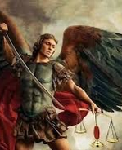
1 John 3:8
God undoes the works of the devil
CCC 395: The power of Satan is not infinite. He is only a creature, powerful from the fact that that he is pure spirit, but still a creature. He cannot prevent the building up of God’s reign.

Slide 10
Know your Enemy
Names of Satan in the bible
Satan - 55
The Devil - 35
The Dragon - 13
The Serpent - 13
The Wicked or Evil One - 11
Beelzebub – 7
The Anti-Christ - 4
The god of this age, ruler of this world, prince of the power of the air - 5
The Tempter - 2
The Father of Lies - 1
A Roaring Lion - 1
Abaddon or Apollyon - 1
Belial - 1

Slide 11
Ephesians 6:11-18
11 Put on the full armor of God, so that you can take your stand against the devil’s schemes.
12 Our struggle is not against flesh and blood, but against the rulers, against the authorities, against the powers of this dark world and against the spiritual forces of evil in the heavenly realms.
13 Therefore put on the full armor of God, so that when the day of evil comes, you may be able to stand your ground, and after you have done everything, to stand.
14 Stand firm then, with the belt of truth buckled around your waist, with the breastplate of righteousness in place,
15 and with your feet fitted with the readiness that comes from the gospel of peace.
16 In addition to all this, take up the shield of faith, with which you can extinguish all the flaming arrows of the evil one.
17 Take the helmet of salvation and the sword of the Spirit, which is the word of God.
18 And pray in the Spirit always with all kinds of prayers and requests. Be alert and keep praying.

Slide 12
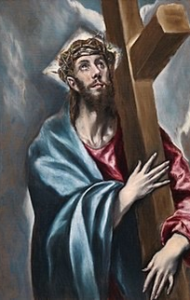
3 foundational weapons for victory
Spiritual Authority
Scripture
State of Grace

Slide 13
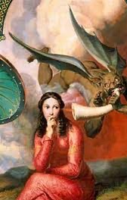
What the devil
CAN & can’t do
CAN NOT MAKE A PERSON SIN
CAN NOT READ YOUR MIND
CAN NOT TOUCH YOUR FREE WILL
CAN NOT TOUCH YOUR INTELLECT
CAN INFLUENCE YOUR MEMORY
CAN INFLUENCE YOUR IMAGINATION

Slide 14
Sight, hearing, touch, smell, taste
    THE PORTAL: MISUSE OF 5 SENSES
    TV, media, music, ingesting cursed food/drinks, illicit touch, ingesting of drugs, occult, Satanic or New Age rituals, mindfulness, witchcraft, seances, Ouija boards, curses, demonic games, magic, tarot cards.
    Religious Syncretism: religious/ cultural superstitions: horoscopes, New Age sage, crystals, charms
    The problem of assigning power to things other than God.

Slide 15
7 Portals
  SIN: habitual, and unconfessed sin,
  WOUNDS: Abuse. Wounds compel people to seek occult practitioners. Unhealed wounds of sins of self and others.
  BROKEN RELATIONS: Unforgiveness. Division of spouses, children, family, parishes, governments.
  INHERITANCE/CURSES: Curses commending a person to the devil; curses to harm person with the help of a demon.
  CONTRACTS: (sin against idolatry)
      Ties to the occult: Deuteronomy 18:10,11,12. Witchcraft, Ouija board, psychic, yoga, crystals, magic (all magic inherently evil), horoscope. If we do these, the devil may claim “rights” to us.
      Dedications: someone dedicates a person to the devil.
      Inviting a demon into your life for personal gain, control (subjugation).
  DEMONS CHOOSE YOU. Especially targets families, youth, college campuses, priests, parishes,
  ENTERTAINMENT INDUSTRY: TV, Media, Music, Literature, video gaming. Render us un-engaged and isolated. Portray evil as good and God as evil.
Notes:
Case: Cursed in womb of mother.

Slide 16
DISCERNMENT
3 spirits
1. the world
2.The Flesh
3.the devil
EITHER/OR VS. BOTH/AND
  NATURAL CAUSES
    Non-practicing Catholic, no sacramental life.
    Clinical mental health diagnosis?
    Various prescription side effects?
    Sinful Lifestyle: Co-habitation, contracepting, chronic marital infidelity, sexual abuse, pornography, new age, occult practices
  PRETERNATURAL: Not Human - Not Divine
    Demonic suffering
      Discern: interior or exterior attacks
      Discern: Onset, frequency,
      Discern: Specific Manifestations.

Slide 17
Ordinary Demonic Activity
Temptation
Deception: devil is the father of lies
Division: devil divides to conquer
Diversion: devil diverts us from God
Destruction: no God, no heaven, no sin
Discouragement: “Accuser” crushes you
Doubt: disbelief in God, Church teaching
Disobedience: Break God’s/Church’s law
Duplicity: double-minded
Distance: avoids deeper relationships

Slide 18
Extraordinary Demonic Activity
5 LEVELS
1. OPPRESSION (Exterior)There is no possession, loss of consciousness, or involuntary action and word, severe to mild attacks.
2. OBSESSION: (Interior) Chronic irrational thoughts, suicidal ideation
3. POSESSION: When Satan takes possession of the body, not the soul. The Major Rite of Exorcism usually required.
4. INFESTATION: Affects houses, animals, things
5. SUBJUGATION: People voluntarily submit to Satan

Slide 19
a New outlook at confession
At the center of forgiveness, is God who embraces us, not the list of our sins.
One is not going to a judge to settle accounts, but to Jesus who loves and heals.
God suffers when we think He can't forgive us, since it’s like telling Him, 'You are weak in love!’ (Pope Francis)
God does not get discouraged with us. We are the ones who are discouraged.
God does not see sinners to label, but children to love.
God does not see people who have erred, but beloved children; perhaps wounded, and in need of His help.
And every time we confess there is a celebration in Heaven. (Pope Francis)

Slide 20
Curses vs. blessings
A curse is the inverse of a blessing.
The origin of curses can be in the present or past.
Syncretism: mixing Catholicism with elements of witchcraft or the occult opens the door to a curse through the sin of idolatry.
A curse can be affected when family members are involved in grievous activities such as gangs, the mafia, drug traffickers, child abuse or prostitution.
A curse may result from a cult or coven members placing a curse, hex, or spell to thwart the work of God by cursing priests, churches, families, officials, ministries.
Video gaming or reading books that promote the practice of spells or curses fosters a climate of ill-wishing.

Slide 21

Stay Free
SACRAMENTAL LIFE: MASS, CONFESSION
LITURGICAL LIFE (Seasons like Advent, Lent)
DAILY MENTAL PRAYER W/ DELIVERANCE PRAYERS
DAILY ROSARY
FASTING AND ALMSGIVING
CONSECRATION
LECTIO DIVINA: SCRIPTURE
KEEP THE TEN COMMANDMENTS (IDOLATRY, ETC.)
DO WORKS OF MERCY
DEVOTIONS: SACRED HEART, DIVINE MERCY, MARY
OFFER UP SUFFERING & REPARATION FOR SIN

Slide 22

Demonic vs. mental illness
MENTAL & DEMONIC: 60%
DEMONIC ONLY: 25%
ONLY MENTAL ILLNESS: 15%
  50% under treatment
  50% diagnosed but not taking medication
Mental Illnesses:
  Clinical anxiety, and depression
  Bipolar
  Hallucinations
  Schizophrenia
  Suicidality

Slide 23
Profile of Diocesan deliverance cases
Religious syncretism
Sexual abuse in family
Divinization, Ouija board, Tarot Cards, Palm Reading, Channeling, Magic
Curses
Non-Catholic Folk Healers: Shaman, Witch, Curandero, Yoga Master, Buddhism, Hindu, psychic,
UNTREATED ADDICTION: Drug, Porn, Alcohol
Work or Family Trauma untreated
Santeria, Santa Muerte
Spousal abuse
Start of conversion/discernment to religious life – demonic oppression began (a seminarian, a nun)
A daily communicant: hypnotized for insomnia by a New Age practitioner became obsessed.
A grandmother joined a Rosary prayer group where they pricked her hand for blood, mixed it with a chicken, and she became demonically obsessed.
Home Infestation: due to religious syncretism in homes.
Trauma wounds

Slide 24
Profile of Cases
5year average
AGE RANGE: 15 to 50
ETHNICITY: Latino (40%), Anglo (30%), Asian (30%)
ECONOMIC: range: homeless to wealthy
EDUCATION: high school to medical doctorate, PhD.
RELIGION: Practicing Catholic (30%), Non-practicing Catholic (60%), Non-Catholic (10%)
VOCATION:
  Clergy, Seminarian (3)
  Religious Sister (3)
  Single (30%)
  Sacramental Marriage (15%)
  Civil Marriage (25%)
  Divorced (25%)

Slide 25
Catholic Resources
30 Day Prescription of Prayer & Rule of Life
Books:
  Discernment of Spirits (Dan Burke)
  A Family Guide to Spiritual Warfare (Beckman)
WEBSITE: www.catholicexorcisms.org
  Online deliverance prayer sessions (pre and post care)
  Website resources include approved prayers for laity

