Slide 1
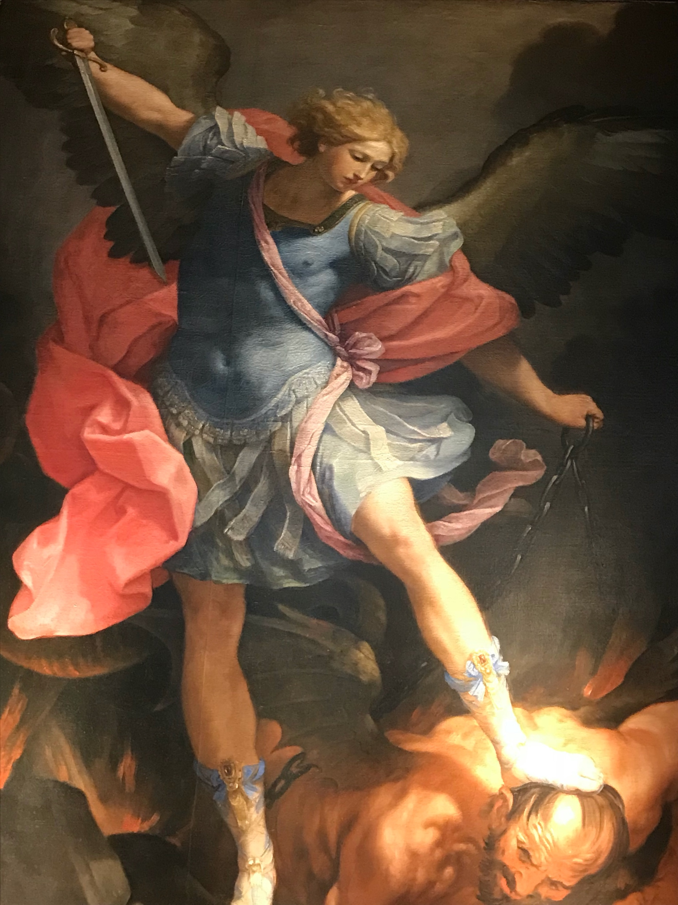

Slide 2
Binding Prayer for Use by Priests
In the Holy Name of Jesus, I invoke the Keys of St. Peter and the Church’s authority and I bind each and every demon in and around _____ and around us. In Jesus’ name I bind them all, and I bind any demons supporting them, their evil leaders, and any minions of Satan. I render them all deaf, dumb, blind and powerless. They cannot tempt, torment, afflict or harm _____ or any of us. I ask the Blessed Virgin Mary to spread her mantle of protection over us. May the Holy Angels surround us, and with the sword of Truth, keep out the evil spirits. I ask the Blood of Jesus to wash over us and to protect us. May it wash over this place, making it a sacred space. I claim each and every person, and this place, for Jesus Christ Our Savior. (SMC)

Slide 3
Satan Attacks the Family
Notes:
I will discuss Mary’s role in an exorcism as well as our experience of related issues in an exorcism.
Much has already been said so I won’t go over the points already made
This is simply our own experience of about 7 years; active ministry being in a large urban capital. Calls pretty much every week. Most complain of demonic attacks- ie demonic oppression, not possession; many their own imaginings; some perhaps real; Demons do oppress us all the time; some rise to the level where real manifestations; unusual pains; bruises; scratches, and so forth. Some are just neurotic and want to ascribe these experiences to the demons- they are hoping for a quick fix. But there are a few cases each year which look like possession. Typically some sort of being involved with occult, or severe trauma in past- living in household where bad stuff happened;
What I will say is just from our experience; I don’t say you have to believe everything or that it is all necessarily true. The only thing exorcists agree on is to disagree. So, I don’t say this is all exactly true; it is just what our team has come up with at this point. But it’s been used over and over again with the cases we have. And I think what we do and have experienced is in consonance with the Church’s teachings; the general experience of exorcists and also of the literature. There is a growing body of modern literature and work which seems to be coalescing around some common principles and experiences in this work.

Slide 4
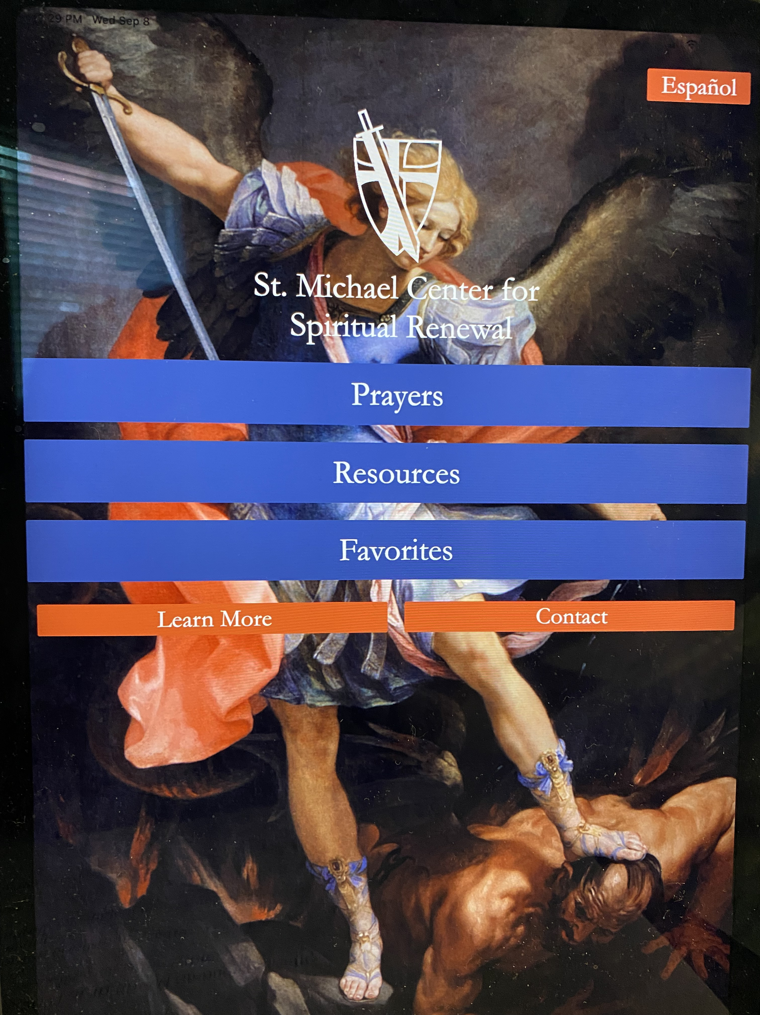
SMC app & website
Download APP:
“Catholic Exorcism”
Go to: www.catholicexorcism.org
Monthly online deliverance sessions: next is Sept 28th
See our “Pray With Me” short videos on our APP/Website

Slide 5
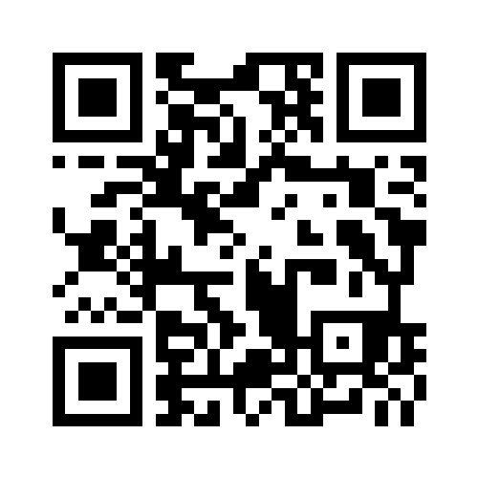
Scan the QR code to go directly to: catholicexorcism.org
St. Michael Center for Spiritual Renewal (SMC) website

Slide 6
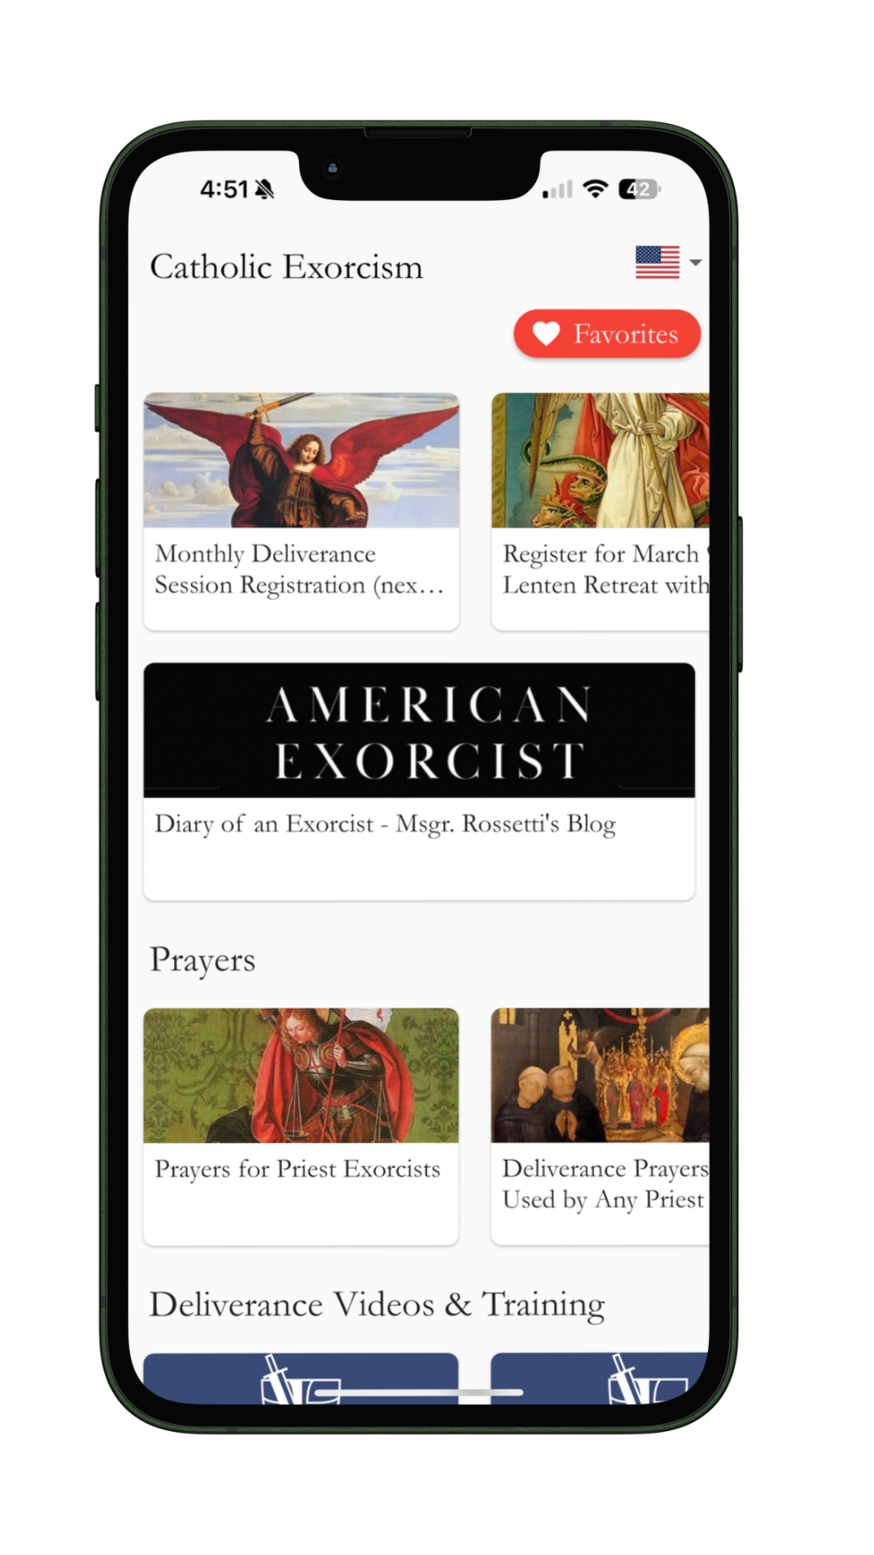




The App & Social Media
YOUTUBE: @stmichaelcenter
@Msgr.Rossetti
@Msgrrossetti
@Msgr.Rossetti
@Msgr.Rossetti
There are approx 400k followers.

Slide 7
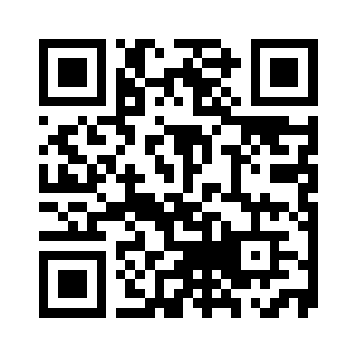
Scan the QR code to go directly to our YouTube channel
St. Michael Center for Spiritual Renewal (SMC)

Slide 8
Satan has a Plan

Slide 9
Satan’s Plan
Destroy the family
Attack the Church
Destroy the Faith
Amass an Army of Followers
Replace Christian values With Agenda of Death
Spread Conflict, Confusion, Violence

Slide 10
Seven Common Demonic
Targets for Harassment
Impeding holy works/ministries
Blocking important human connections
Breakdown family unity
Financial distress
Impeding Mass attendance & sacraments/prayers
Messing with our technology
Overt harassment

Slide 11
God has a Plan

Slide 12
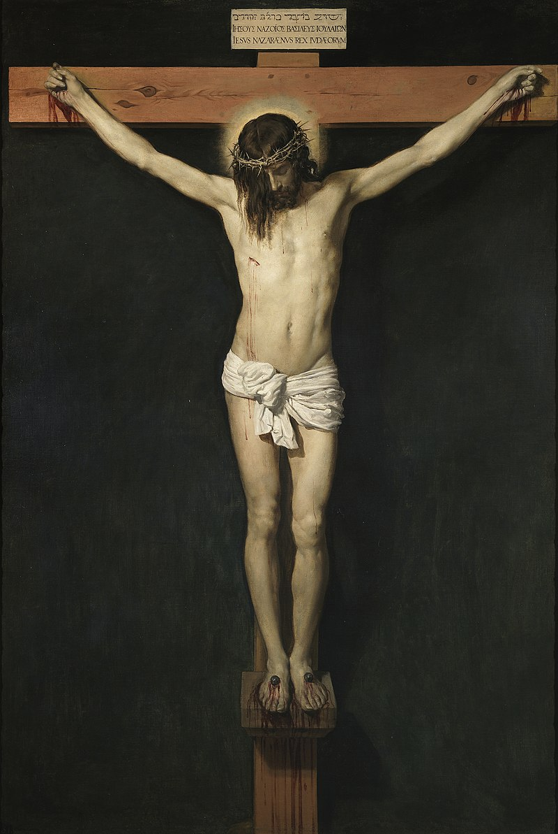

Slide 13
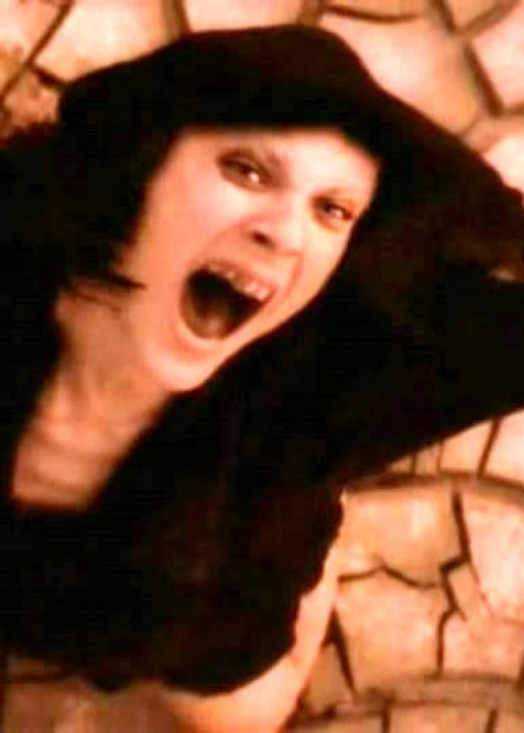
On the cross, Satan’s kingdom is destroyed.

Slide 14
Rite of Exorcism:
“Why do you resist, knowing that Jesus brings your plans to nothing?”

Slide 15
“Jesus is Lord.”

Slide 16
Signs of Satan’s Presence
Discord (causa discordiae)
Rage & victimization
Isolation
Decline of faith (inimice fidei)
Vice & sin (fomes vitiorum)
Dissolution of family and gender roles
Hatred of Catholic Church
Notes:
Fomenter of vice, carrier of death, prince of accursed murder

Slide 17
a normal conflict
vs.
a demonic attack

Slide 18
Signs of a demonic attack
*Sudden
*Unexplained
*Uncharacteristic
*Out of proportion
*Grows in silence and isolation
*Sows distrust and conflict

Slide 19
How to Protect the Family
Attend Mass together
Pray together, esp. family rosary
Sacramentals in house
House blessed
If Satan has targeted your family, it may mean that you are doing something right and holy!

Slide 20
“Jesus is Lord.”

Slide 21
Question
If a member of our family is practicing witchcraft, occult or any divination, will it affect the rest of the family?

Slide 22
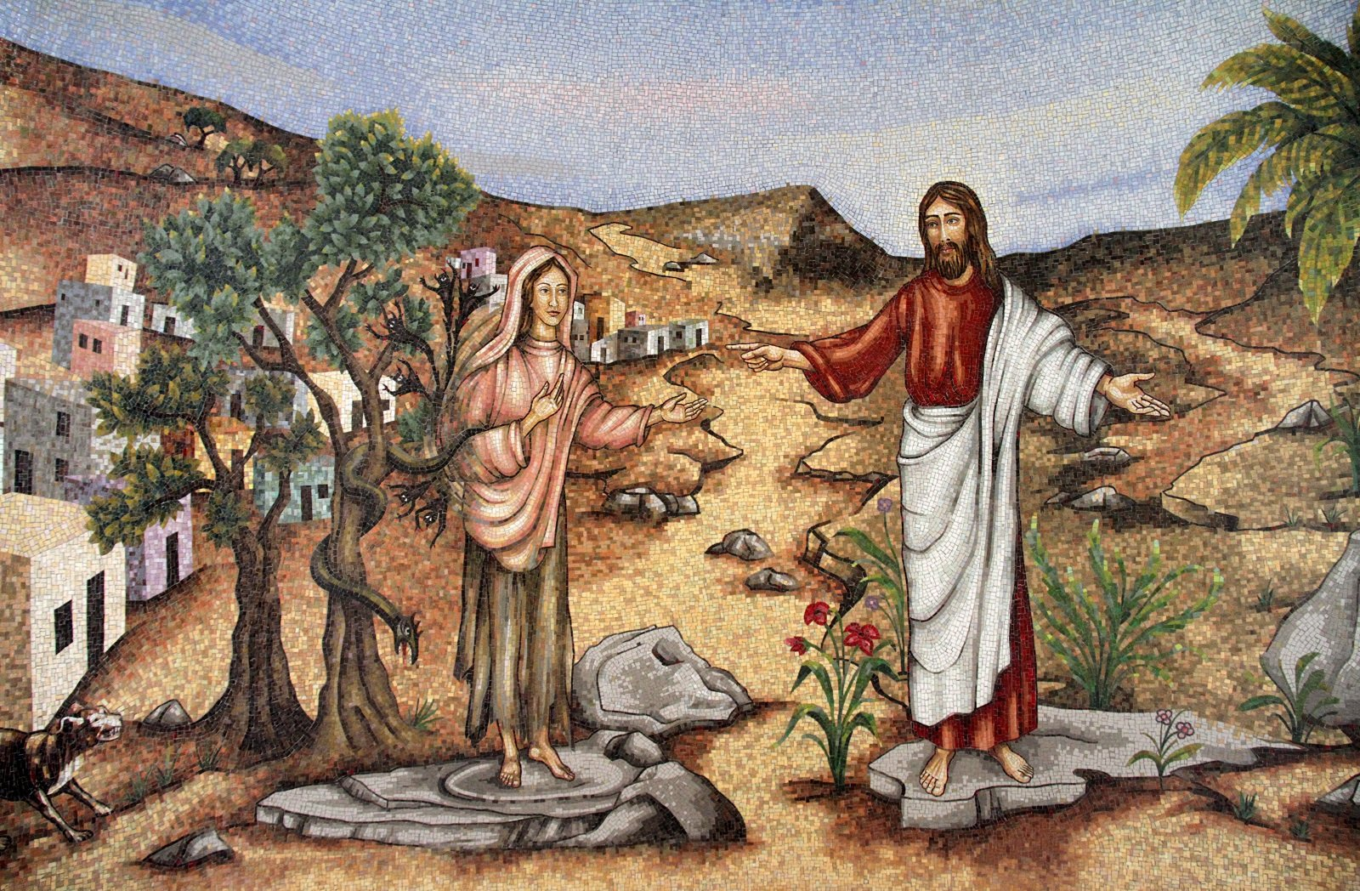

Slide 23
Which sacramentals to use?
Holy Water
Crucifix
Holy Statues
Pictures of Saints
Exorcized salt
Exorcized oil
Benedictine medals
Rosary/scapulars
Others…

Slide 24
How to deal with conflicts
Use ”I” statements not ”you” accusatory statements
Do not judge
Do not presume you know what the other is thinking and feeling
Communicate, communicate, communicate
Forgive again and again and again:
    77 times 7 times

Slide 25
How to deal with conflicts (cont)
Have realistic expectations: Any real, lasting relationship requires hard work and is difficult
Obedience to family roles
Love is not a feeling; it is a choice/act of the will
Being upset and angry doesn’t mean you don’t love someone
But don’t go to bed angry

Slide 26
Question
If a relative is into witchcraft and the occult, should I let the person into my home? Can I be such a person’s friend?

Slide 27
Demonic Infestation of Houses
Notes:
Blessing a house vs exorcizing a house

Slide 28
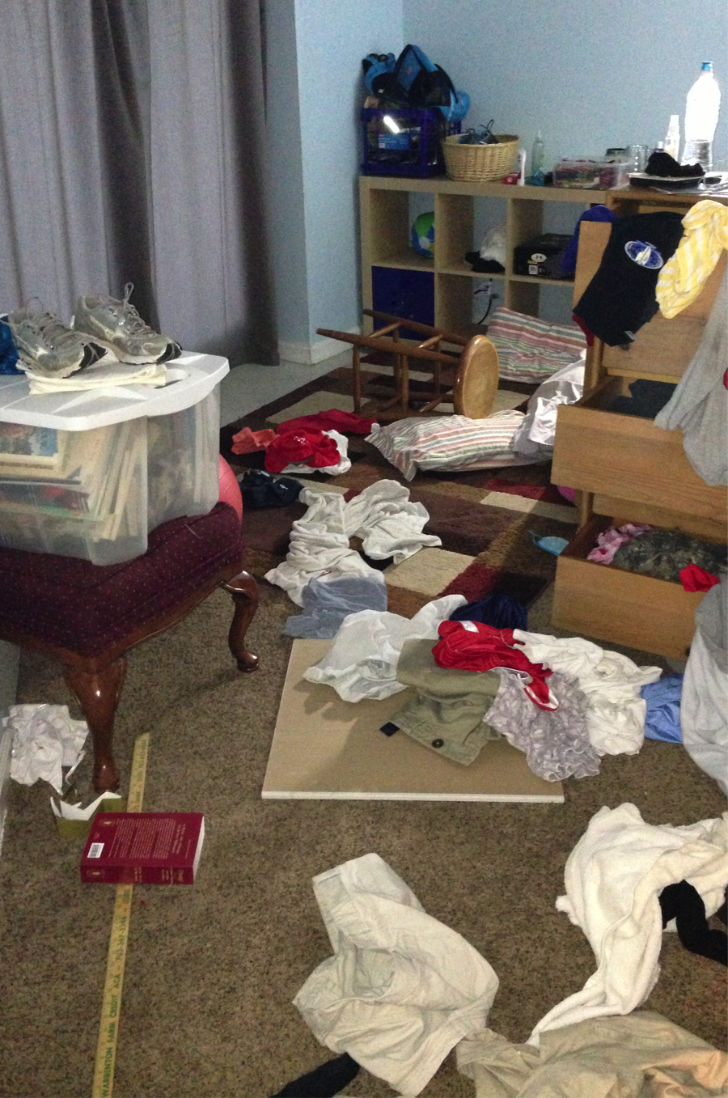

Slide 29
15 signs of a demonic presence in the house
Horrible smells like a rotting dead animal
Great temperature drops in areas of the house;
Doors/windows inexplicably closing & opening
Electronics going haywire
Dogs howling in a frightened tone
Objects moving without explanation or disappearing
Thumping and banging sounds which have no apparent origin
Globes of light crossing the room
Dark shadowy figures or "shadow men"
People being inexplicably shoved or pushed, including on stairs
Whistling or ugly voices calling to people
An overwhelming sense of fear and/or nausea
Messages to "Stop" (if prayers are being said) or "Get Out" conveyed perhaps scrawled on a mirror or heard verbally
A feeling one's body is being touched or even scratched or bruised

Slide 30
15 signs… (cont)
Globes of light crossing the room
Dark shadowy figures or "shadow men"
People being inexplicably shoved or pushed
Whistling or ugly voices calling to people
An overwhelming sense of fear and/or nausea
Messages to "Stop" (if prayers are being said) or "Get Out"
A feeling one's body is being touched or even scratched or bruised

Slide 31
Is it the house?
The people in the house?
Or both?

Slide 32
Some bad histories resulting in infestation
Abortions & related deaths (Brownsville Rd)
Occult rituals & child abuse (Ohio man)
Drug, sex trafficking, shootout with many deaths (MD house)
Child abuse & occult rituals (Catholic bldg)
Possessed people almost always have demons in their houses

Slide 33
Question
Should I buy antiques? Could they be cursed?
How do I know if an object has been cursed?

Slide 34
Ohio House Infestation 2019
Background: On phone call, individual “A” said family is largely not believers. But they took over the house after the previous occupant died; he was molesting minors and also into occult practices. He died in April and the manifestations started about in June.
Some of symptoms: seeing dark shadowy figures; radical temperature drop in isolated places in the house e.g. from 70 to 30’s. The dog starts barking uncontrollably. “Voice” in basement calling to their children. Strange noises and banging. Some presence gets on “A”’s chest and he can’t move or barely breathe. He finally commanded it in the name of Jesus to leave and it did. Family is terrified and they were all sleeping in one room together.
Family heard loud bangs, heard a voice say hey and whistling and went downstairs stairs sounded like something jumped on floor above and things shook like someone did jump on floor above
Father said something touched my daughter’s leg and daughter said she saw a small shadow figure.

Slide 35
Ohio House Infestation (cont 2)
Heard kitchen drawers slam shut, walking around sounds, my wife felt breeze of air while laying in bed like something walked past her, while wife was in shower the bathtub was making creaking sounds like something was in bathtub with her (she was standing still) and sounds of something tapping on our plastic surround wall of shower while she was showering.
Father said: Today’s conversation with the local priest was bad because I felt as if he didn't believe me and the things my family and I have experienced. These things are very real, very scary, and very nasty. I feel like until someone experiences these things that they don't understand what we're going through and how they have affected everything.
[After first priest visit] Msgr Stephen Rossetti asked:
Would you say that things are somewhat better since the first time he prayed at your house or would you say they are about the same?
Father’s response: I would say things are better because before things were really bad. The sounds of walking on the floor and the sounds of banging and tapping have returned.

Slide 36
Questions
Can I bless my own home?
Is an exorcism of place the same as a house blessing?

Slide 37
Do house blessings “work”?
Conversation with a possessed woman:
Possessed Woman: Did you do something to my room?
Priest-exorcist: Why do you ask?
Possessed Woman: You blessed my room.
Priest-exorcist: How could you tell?
Possessed Woman: Something changed. They [the demons] hated it. They still do.

Slide 38
Question
Do ghosts exist?
How do I know if its a ghost?
What do I do about it?

Slide 39
Demons feed off:
*Unforgiveness
*Anger
*Victim mentality
*Fear
*Isolation
*Judgmentalism

Slide 40
An Act of Forgiveness
Note: Forgiveness does not mean that what the person did to harm someone was okay. It also does not mean the one hurt should have “warm feelings” about the other person. Rather, it is an act of the will to let go of the hurt and to will the good of the other. Demons feed off unforgiveness. Unforgiveness can dysfunctionally bond the person to the abuser and the one harmed can remain a perpetual victim, under the control of the abuser. Forgiveness allows the person to let go of the harm, to be open to God’s healing, and to be set free.
PEOPLE: In the name of Jesus Christ, I willingly forgive anyone who has hurt or harmed me (including N., etc...).
I forgive them from the bottom of my heart and I ask God to bless them. (3 times)
I willingly forgive myself. I renounce the evil spirit of self-hatred. I accept God’s forgiveness. And I ask God to bless me. (3 times)

Slide 41
Prayer to Cast Out Specific Evil Spirits
In this prayer, we will reject specific evil spirits that may be affecting an individual or family members. The person will name them and reject them; the priest will then command them to leave. This might include the evil spirits of depression, lethargy, division, rejection, self-hatred, abuse, addiction, anger, anxiety, sexual afflictions, etc.
PEOPLE: In the holy name of Jesus, I bind the evil spirits of ... (mention yours silently).
I rebuke you, I reject you, I renounce you and I cast you out. (3 times)
PRIEST: In the Most Holy Name of Jesus, by the authority of my priesthood, I invoke the keys of St. Peter and I ratify your rejection of these evil spirits and, in Jesus’ name, I cast them out! Vade retro Satanas.

Slide 42
Prayers for Physical & Emotional Healing
PRIEST: Heavenly Father, trusting in your overflowing generosity and mercy, we open our hearts now and offer you our specific needs. We beseech you for any physical healings needed for us or our loved ones, casting out all evil spirits of infirmity (e.g. cancer, autism, auto-immune disorders, neurological problems, COVID, long COVID, all cancers, eye and vision problems, lung problems, psychotic illnesses, kidney, liver...) We also beseech you for much needed emotional healings as well (addictions, depressions, anxieties, wounds of sexual and physical abuse, gender confusion, compulsions, anger, inner wounds, same-sex attractions, father wounds, narcissism, family conflicts and discord .....). We especially remember all those intentions sent to us or intentions that people bring with them now: (PEOPLE now mention the healing graces they desire.) Father, we especially bring the needs of our family members, especially our children- those who have fallen away from the faith, those who suffer in any way, especially due to family discords and conflict. May Michael, Raphael and Gabriel the archangels come to us, casting out the darkness, casting out the evil spirits of infirmity, and bringing God’s healing graces. Heal us. Sanctify us. Make us whole. In the name of Jesus be healed. In the name of Jesus be at peace.

Slide 43
Prayer to Remove Generational Spirits
PEOPLE: I reject any generational curses, occult practices or evil spirits sent against me or my family members and I ask Jesus to cast them out. In his holy name, may He cast them out. (3 times)
PRIEST: In the name of the Lord Jesus + Christ, and by the power of his Word, I take the sword of the + Spirit and cut you all free from all generational inherited sins, weaknesses, character defects, personality traits, cellular disorders, curses, and genetic disorders. I sever all unhealthy soul-ties and forms of enmeshment and cut all bonds that are not of the Lord. I put his cross between you, your parents, your grandparents and ancestors, your siblings, your offspring, your spouse, and any unhealthy relationships that you or anyone close to you have had with others in the past. I cut all bonds of these relationships that are not of the Lord back to the beginning of time, and by the sword of the Spirit, and in the name of Jesus + Christ, I say that you are free, free to be the child of God the Lord intended you to be. (Cabading p. 43) [Imprimatur, Cardinal Tagle]

Slide 44
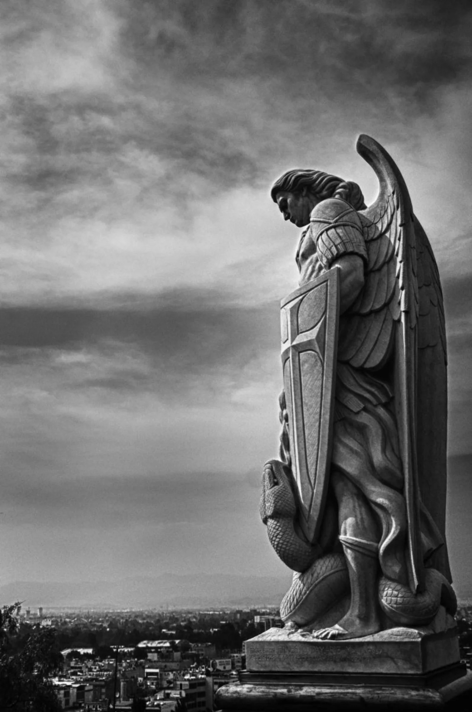
Deliverance Prayer by Fr. Gabriel Amorth
Liberate us from all evil and all diabolic disturbance. You who through the death and resurrection of Jesus Christ, your beloved Son, has delivered us from the power of darkness and death and has translated us into Thy Kingdom of light and holiness, free our brothers/sisters now from all domain and connection to Satan and his angels. Free them of all evil forces, crush them, destroy them so that they can get well and live according to Thy most Holy Will. Deliver them from all malefices, from witchcraft, from black masses, from spells, from maledictions, from evil eye, from satanic rites, from satanic cults, from consecrations to Satan. Destroy all connections to Satan and to all people connected to Satan, living or dead. Deliver them from all diabolical infestations, from all diabolical possession, from all diabolical obsession, and from all sin or consequence of sin. Destroy all these evils in hell, that they may never torment them again or any other creature in the entire world.

Slide 45
God the Father Almighty, I beseech Thee, in the Name of Jesus Christ our Savior and through the intercession of the Immaculate Virgin to order all unclean spirits, all the powers that molest them and their loved ones to leave them immediately, and to leave them forever and to be consigned into the everlasting hell, where they will be thrust by Saint Michael the archangel, Saint Gabriel, by Saint Raphael, by our Guardian Angels, crushed beneath the heel of the Blessed Virgin Mary our Immaculate Mother. Thou who has created man in Your own image and likeness in holiness and justice and has not forsaken him after sin, but with wise providence saved him through the mystery of the incarnation, passion, death and resurrection of Thy most beloved Son, save your servants and deliver them from evil and from the enemy's slavery; banish from them the spirit of lying, pride, lust, greed, anger, envy, gluttony, sloth, and all kinds of evil. Receive them in Thy Kingdom, open their hearts to understand Thy Gospel, so that they may live always as a child of light, may witness the truth and practice works of charity according to Thy commandments. With the breath of Thy mouth, Lord, cast the evil spirits out: order them to leave because Thy Kingdom come. Through our Lord Jesus Christ, Your Son, who is God with You in the unity of the Holy Spirit.
R. Amen.
The Lord free you from all evil, in the name of the + Father, and the Son and the Holy Spirit. R. Amen.

Slide 46
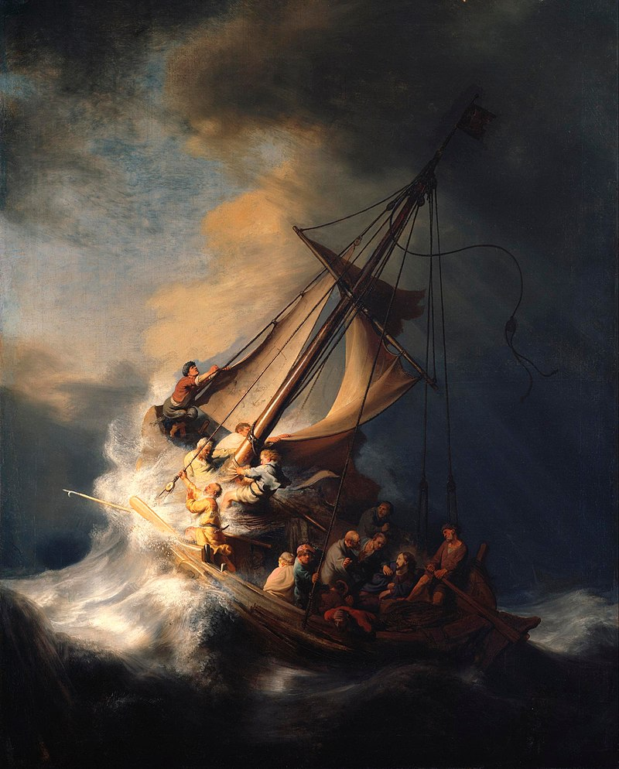
Stay in the Boat!

Slide 47
“Jesus is Lord.”

Slide 48
Cleansing Prayer
PRIEST: Heavenly Father, in the Name of Jesus Christ our Lord and Savior, by the power of the Holy Spirit, we pray that the cleansing power of the precious blood of Your Son come upon us right now. Purify us and wash us clean with the blood of Jesus from the top of our heads down to the very soles of our feet. Let this blood cleanse us from any entanglement from any evil spirits we have come in contact with during our session. May the BVM spread her mantle of protection over us always. Anoint us with the gifts of the Holy Spirit and refresh our body, soul, and spirit, and may the sign of Your holy cross drive away all evil spirits from us. In the Name of the Father + and the Son and of the Holy Spirit. Amen.

